Slide 1

Takeoff - Online Crowdfunding platform
Sujan Shrestha – np000611

Slide 2
Introduction
With a vision to empower Nepalese innovators and visionaries, this project aims to establish a dynamic online crowdfunding platform that not only catalyzes the realization of creative ideas but also fosters sustainable startup ventures. By bridging the gap between visionary creators and enthusiastic investors, an online crowdfunding platform sets out to be the catalyst for transforming imaginative concepts into tangible successes.
In a country where budding creators often struggle to find avenues for showcasing their innovative ideas, this crowdfunding platform in Nepal emerges as a beacon of opportunity. Our platform serves as a nexus for synergies between creators and investors, resulting in a harmonious convergence of visionary ideas and capital infusion.

Slide 3
Problem statement
Lack of Funding Accessibility: Nepalese innovators face challenges accessing adequate funding due to traditional financial mediums' stringent criteria.
Limited Visibility: Many promising projects struggle to gain visibility beyond local surroundings, hindering their access to potential backers.
Geographical Barriers: The diverse and dispersed population of Nepal poses additional challenges for creators to reach a broader audience for raising capital.

Slide 4
Ideas and strategies
Platform Development: Create an intuitive and secure crowdfunding platform accessible to creators and investors.
Community Building: Foster a sense of community and collaboration among users through forums, events, and networking opportunities.
Partnerships: Collaborate with financial institutions, businesses, and organizations to expand reach and offer additional services.
Education and Support: Provide resources and guidance to help creators navigate the crowdfunding process effectively.

Slide 5
Unique Selling point
Tailored for Nepalese innovators
Global Reach
Comprehensive Support
Community Engagement
Streamlined Process
Token and Gamification
Multiple campaigns availability

Slide 6
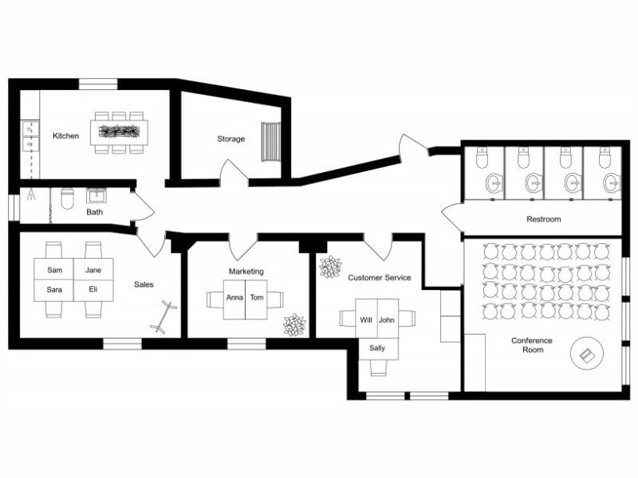
Floor plan (server from third party)

Slide 7
Revenue Streams
Transaction Fees
Premium Features Subscription
Advertising Partnerships
Sponsorship and Partnerships
Data Insights Monetization

Slide 8
Framework to consider roi
Metrics:
Number of Successfully Funded Projects
Total Funds Raised
User Engagement Metrics (e.g., Time spent on platform, Number of interactions)
Customer Acquisition Cost (CAC)
Customer Lifetime Value (CLV)
ROI Analysis:
Evaluate ROI based on the platform's revenue generation compared to investment in development, marketing, and operational costs.

Slide 9
Revenue plan
Transaction Fees: Charge a small percentage fee on successfully funded projects.
Premium Features Subscription: Offer advanced features and services for a monthly or annual subscription fee.
Advertising Partnerships: Collaborate with relevant businesses for targeted advertising opportunities.
Sponsorship and Partnerships: Seek sponsorship or partnership opportunities with financial institutions or organizations.
Data Insights Monetization: Monetize anonymized user data by offering insights and analytics to interested parties.

Slide 10
Marketing plan
Target Audience: Nepalese innovators, investors, businesses, and organizations.
Strategies:
Digital Marketing: Utilize social media, content marketing, and search engine optimization (SEO) to reach target audiences.
Partnerships: Collaborate with influencers, industry experts, and organizations for endorsements and promotions.
Events and Workshops: Host webinars, workshops, and networking events to educate and engage the community.
Public Relations: Leverage press releases, media coverage, and partnerships to increase brand visibility and credibility.

Slide 11
THANK YOU

